Slide 1

Gas: Social, environmental and economic concerns
Francesco Gardumi
gardumi@kth.se
Introductory lecture – Energy commodities and technologies
This work by OpTIMUS.community is licensed under the Creative Commons Attribution 4.0 International License. To view a copy of this license, visit http://creativecommons.org/licenses/by/4.0/.

Slide 2
Commodity: global trends
Demand
Supply
Resources

Slide 3
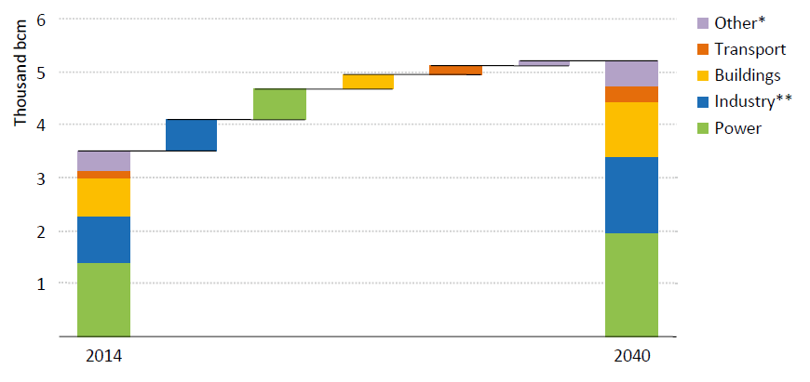
Demand
World gas demand by sector in IEA New Policies Scenario
Source: IEA World Energy Outlook 2016.
Notes:
Power generation and industry share most of the global gas demand growth

Slide 4
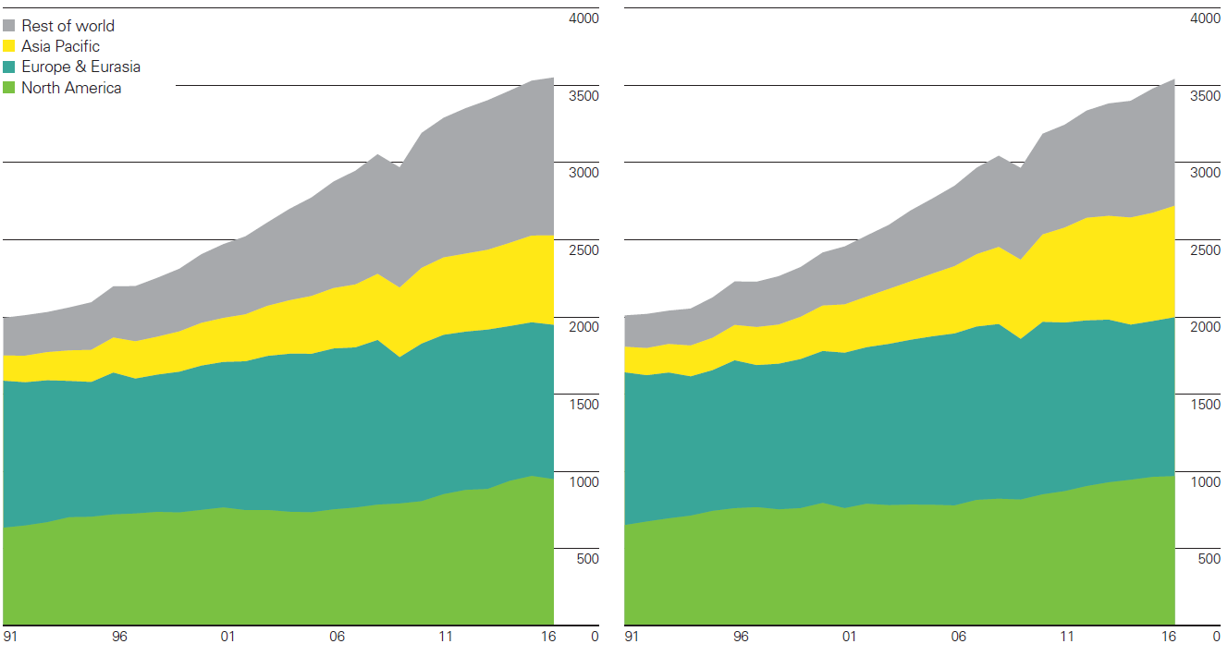
Supply
Gas production (billion cubic metres) Gas consumption (billion cubic metres)
Source: BP Statistical review of World Energy 2017.

Slide 5
Resources
Conventional resources:
NG: mixture of hydrocarbons containing mostly methane (c.ca 90% mole), ethane (5%), propane and butane. Raw gas can contain significant quantity of sulphur and must be treated.
LNG: Natural Gas that has been liquefied for ease of storage and transport. The chain includes liquefaction facilities, transport usually in ships, re-gasification facilities.
Unconventional resources:
Tight gas: natural gas produced from reservoir rocks with very low permeability, requiring intensive hydraulic fracturing (fracking) for economic production. Mostly US.
Shale gas: natural gas found trapped in shale formations (clastic sedimentary rocks). Produced by fracking. Biggest production currently in US. Biggest reservoirs estimated in China.
Coalbed methane: natural gas extracted from coal beds. Produced mainly in US, Canada, Australia.

Slide 6
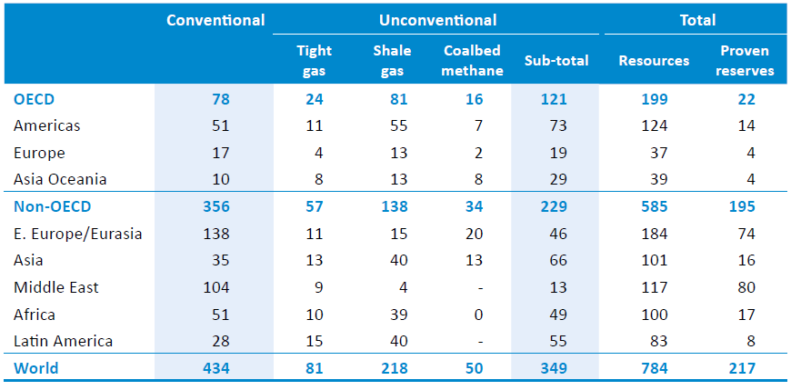
Resources
Proven reserves = 90% probability to be extracted profitably
Reserves to Production ratio (R/P) of around 50 years
Gas resources (tcm)
Source: IEA World Energy Outlook 2016.
Notes:
These figures haven’t changed significantly since IEA World Energy Outlook 2015.
The reserves to production ratio (R/P) represents the length of time that proven reserves would last if production was to continue at current rates.

Slide 7
Technologies in the gas chain
Extraction
Transportation and storage
Combustion-based power plants
Economic, Environmental and Social concerns

Slide 8
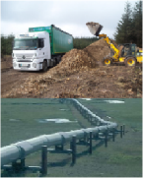

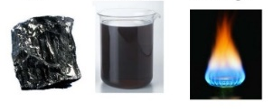

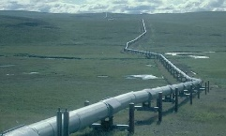

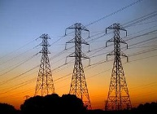


Sample Reference Energy System
Import / Extraction+processing of fossil fuels
Fuel transportation
Energy demand
Transportation sector
Gas
Combustion-based
power plant
Gas distribution
Energy demand
Residential sector
Electricity
Electricity transmission and distribution
Nuclear
power plant
Energy demand
Commercial sector
Energy demand
Industrial sector

Slide 9
Extraction
Key characteristics
Conventional gas
Capital cost | 5.3-63.7 $/boe
VOM cost | 3.2-8.3 $/boe
Recovery factor | 70-80%
Energy use | 0.8-2.3 GJ/toe
CO2 Em. factor | 64.9-273.6 ton/ktoe
Unconventional gas
Capital cost | -
VOM cost | 6.6-19.7 $/GJ
Recovery factor | 10-70%
Energy use | 20-30% of produced
CO2 Em. factor | 9.3-15 gCO2/MJ
Processes - conventional gas:
Conventional wells: lately case drilling is used
Deepwater production: made possible by floating platforms. 3000 m reached in 2005.
Processes - unconventional gas:
Hydraulic fracturing: used for tight gas, shale gas and coalbed methane. It consists in pumping high-pressure liquid in the rocks to fracture them and ease the gas flow. Coupled with horizontal wells.
Notes:
Case drilling: after the well is drilled, a diameter casing is inserted and fixed with cement (one of the things which failed in deep water horizon).

Slide 10
Transportation and storage
Key characteristics
Pipeline
Capital cost | 194-226 M$/km
Energy use | 1.8-2.7% of transported
LNG liquefaction
Capital cost | 2.9-3.8 $/MMBtu
VOM and FOM cost | 10500 $/ton
Natural gas losses | 15%
LNG shipping
Capital cost | 245 M$/150000 m3
Energy use | Diesel, NG, HFO
CO2 Em. factor | Depends on fuel
LNG re-gasification
Capital cost | 45-75 $/ton
Transportation
Pipelines: used for short to medium distances (including distribution to final users) and large volumes.
LNG shipping: for long distances and large volumes. This technology also includes liquefaction and re-gasification facilities.
Storage
Natural gas is stored for commercial or energy security reasons.
Underground storage: in depleted gas reservoirs or salt caverns.
On-board LNG fleets.

Slide 11
Combustion-based power plants
Key characteristics
OCGTs
Capital cost | 900 $/kW
VOM and FOM cost | 36 $/kW/a
Lifetime | 30 years
Efficiency | 35-42%
CO2 Em. factor | 480-575 kg/MWh
CCGTs
Capital cost | 1100 $/kW
VOM and FOM cost | 44 $/kW/a
Lifetime | 30 years
Efficiency | 52-60%
CO2 Em. factor | 340-400 kg/MWh
Open Cycle Gas Turbines (OCGTs):
Typical size between 10 and 300 MW. Fast ramping, usually used for peak generation. Also fed with oil products.
Combined Cycle Gas Turbines (CCGTs):
One unit consists in a Gas Turbine + a Heat Recovery Steam Generator (HRSG) with a Steam Turbine. Power plants usually combine 2 or 4 of these units. Largely used and efficient, flexible, but not as much as OCGTs. Used for both base and peak generation.

Slide 12
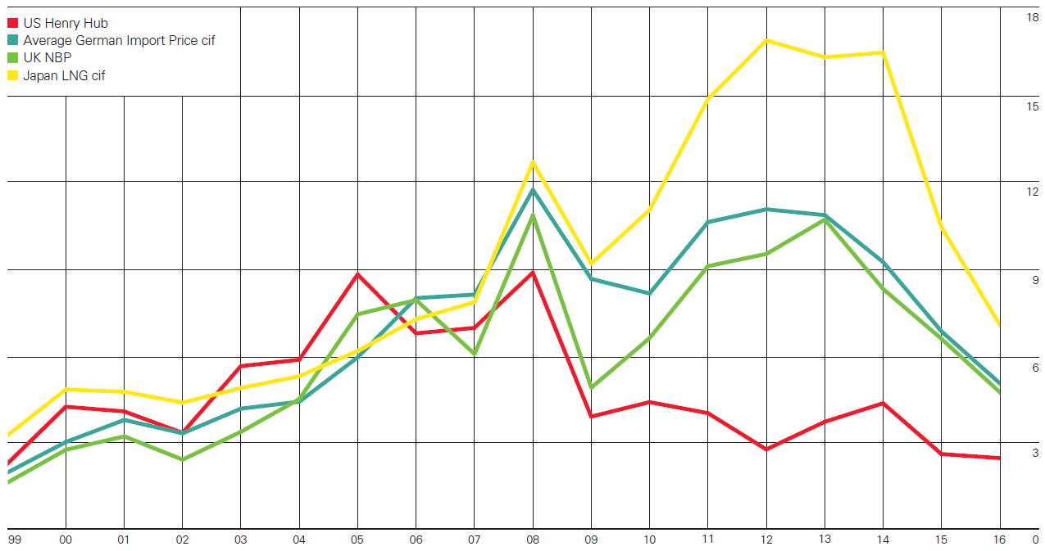
Economic concerns
Are prices of oil and gas still coupled?
Spot prices of NG on selected markets compared to LNG and Oil prices [US $/million Btu]
Source: BP Statistical Review of World Energy 2017
Notes:
Ask the attendants. From the figure we can see that in a few markets the prices went up until 2014 then dropped, as happened for oil.
However, this was not the case for the US, where much earlier the exploitation of shale gas started and the prices dropped. There could be a balancing of prices if the US started a big trans-oceanic trade of LNG.

Slide 13
Economic concerns
Greater geopolitical concerns about the role of natural gas in the international relationships:
Competition between 1) the SouthStream project launched by Gazprom and initially supported by ENI (now abandoned), bringing gas from Russia, and 2) Nabucco, backed by several EU Member States, bringing gas from Iran and Azerbaijan.
New reservoir discovered offshore Israel – Cyprus – Egypt – Lebanon – Syria. How is it going to affect the relations and diplomacy between the countries?
Just when the revolution came in 2011, Syria had approved a pipeline from Iran, while rejecting one from Qatar through Saudi Arabia.

Slide 14
Economic concerns
In addition, big discussion ongoing in some markets (e.g. Europe) about the role of NG-fired generation in the power system in the next decades:
Increasing penetration of renewables causes generation to be intermittent
Gas-fired power plants are fast ramping and will be called to balance intermittency
This turns to be economically unsustainable for the operators of the power plants

Slide 15

Environmental and social concerns
Environmental concerns:
The combustion of gas (e.g. for electricity generation or transportation) is again responsible for emissions at local, regional and global level, such as CO2, NOx, SOx;
In addition, Methane (CH4) is a GHG with 20 times stronger effect than CO2! Any direct emission of CH4 from gas leaks through the production chain contributes to the global warming.
Social concerns:
Similar concerns to those for Oil apply.

Slide 16
Conclusions

Slide 17
There is high demand for gas and it is expected to increase, especially in the power sector;
Gas is less CO2 intensive than oil and coal. Replacement of the latter with gas will decrease the pressure of GHGs emissions;
Gas-fired generation is flexible enough to provide backup for large shares of variable renewables in the electricity supply;
Still, gas shares most of the economic, environmental and social concerns of oil.

Slide 18
References and reading material

Slide 19
IEA, World Energy Outlook 2016;
British Petroleum, Statistical Review of World Energy 2017. Available at: https://www.bp.com/content/dam/bp/en/corporate/pdf/energy-economics/statistical-review-2017/bp-statistical-review-of-world-energy-2017-full-report.pdf;
IEA-ETSAP, Energy Technology Data Source. Available at: https://iea-etsap.org/index.php/energy-technology-data;
How natural gas could be a geopolitical game-changer in the Mideast: https://www.youtube.com/watch?v=pay5dKYvXGU
Profit Pollution and Deception BP and the Oil Spill: https://www.youtube.com/watch?v=8zGFvzMMO9w&t=706s

Slide 20
Sources for the pictures
Gasification: http://www.gbgasifired.com/model.html
Extraction: http://www.energytrendsinsider.com/research/coal/coal-mining-and-processing/
Refinery: http://stillwaterassociates.com/crack-spread-a-quick-and-dirty-indicator-of-refining-profitability/
Biomass: http://inhabitat.com/tag/biomass/
Renewables: http://www.topnews.in/wind-water-and-sun-beat-biofuels-nuclear-and-coal-clean-energy-297577
Uranium: http://unitednuclear.com/index.php?main_page=product_info&products_id=1028
Fossil: https://www.slideshare.net/MMoiraWhitehouse/fossil-fuels-teach
Combustion based power plants: https://en.wikipedia.org/wiki/Battersea_Power_Station_in_popular_culture
Uranium enrichment: http://energyfromthorium.com/2010/08/06/loveswu1/

Slide 21
Sources for the pictures
Residential: http://jhsimpson.com/residential/
Transport: https://se.123rf.com/clipart-vektorer/transport.html
Industry: http://indianexpress.com/article/business/economy/factory-output-grows-2-per-cent-in-february-after-3-months-of-contraction/
Commercial: http://www.alfalaval.com/industries/refrigeration/commercial-refrigeration/
Transportation of fuel: http://www.zerohedge.com/news/2017-06-23/demand-oil-pipeline-capacity-hits-6-year-low
Transportation of biomass: http://www.forestenergy.ie/transportation-studies.php
Transportation of oil products: http://www.picquery.com/gasoline-truck_WXRZaplkZ2eaRVifu*zjqPAvrMnnxmBsTSgdn*BBBKk/
Decentralized energy supply: http://trayamtechnologies.com/solar-pv-roof-top-and-ground-mounting/
Decentralized energy supply2: http://www.sunwindenergy.com/photovoltaics/38-mw-rooftop-pv-system-completed-uk

Slide 22
Changelog and attribution
Date | Author | Reviewer | Reviser
2017-09-23 | Francesco Gardumi | Francesco Fuso Nerini | Francesco Gardumi
To correctly reference this work, please use the following:
Gardumi, F., 2017. Gas: Social, environmental and economic concerns, OpTIMUS.community. Available at: http://www.osemosys.org/understanding-the-energy-system.html. [Access date]

